Slide 1
NAME:YASAR A
REGISTER NO:211521104185
DEPT:COMPUTER SCIENCE ENGINEERING
3/21/2024 Annual Review

Slide 2
PICTURE CREATION USING GNN
Training Phase: During this phase, two neural networks are trained simultaneously:
Generator: This network generates images from random noise or a seed. It starts by creating noisy images but improves over time to produce realistic ones.
Discriminator: This network's job is to distinguish between real images from a dataset and fake images produced by the generator. It learns to improve its ability to differentiate as training progresses.
Generation Phase: Once trained, the generator network can be used independently to produce new images. You provide it with random noise as input, and it outputs an image. The quality of generated images depends on the quality of training data, network architecture, and training parameters.
..
3/21/2024 Annual Review

Slide 3
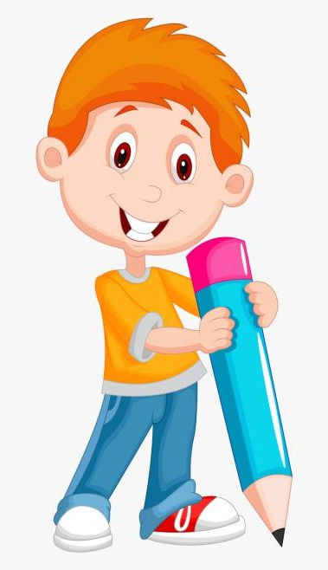

AGENDA
Problem Statement
Project Overview
Who Are The End Users?
Your Solution a nd Its Value Proposition
The Wow In Your Solution
Modeling
Result
3/21/2024 Annual Review

Slide 4
PROBLEM STATEMENT
Picture creation using Generative Adversarial Networks (GANs) is a challenging task with numerous practical applications, ranging from artistic creation to data augmentation in computer vision tasks. Despite the progress made in recent years, there remain significant challenges in producing high-quality, diverse, and realistic images consistently. The problem statement revolves around developing novel techniques and architectures within the framework of Generative AI.
3/21/2024 Annual Review

Slide 5
PROJECT OVERVIEW
The primary objective of this project is to explore the capabilities of GEN AI, a specialized implementation of GANs, in generating high-quality images across various domains. We aim to leverage the power of deep learning to create visually appealing and diverse images while maintaining realism and coherence.
3/21/2024 Annual Review

Slide 6

WHO ARE THE END USERS?
Graphic Designers and Artists: These professionals may use image generation AI to quickly generate visual concepts, explore ideas, or even create entire artworks.
Content Creators: Bloggers, YouTubers, and social media influencers might use image generation AI to create engaging visuals for their content, such as thumbnails, banners, or social media posts.
Marketing and Advertising Professionals: Marketers can use image generation AI to create compelling visuals for advertising campaigns, product mock-ups, or personalized content tailored to specific demographics.
3/21/2024 Annual Review

Slide 7
YOUR SOLUTION AND ITS VALUE PROPOSITION
Solution:
Generative Adversarial Networks (GANs): GANs consist of two neural networks - the generator and the discriminator. The generator generates images, while the discriminator evaluates them for realism.
Training Process: The generator initially produces random images, which are then evaluated by the discriminator. Over time, both networks improve iteratively through adversarial training, where the generator aims to create images that can fool the discriminator, and the discriminator gets better at distinguishing real images from fake ones.
Value Proposition:
High-Quality Image Synthesis: GANs can produce high-quality, realistic images with fine details, enabling applications in art, design, and entertainment.
Data Augmentation: GANs can generate synthetic data to augment training datasets, which is particularly useful when labeled data is scarce or expensive.
3/21/2024 Annual Review

Slide 8
THE WOW IN YOUR SOLUTION
Our image generation solution utilizing GEN AI pushes the boundaries of creativity and realism like never before. By harnessing the power of cutting-edge deep learning algorithms, our system generates stunning images that captivate the imagination and defy expectations. Whether you're seeking lifelike portraits, breathtaking landscapes, or futuristic concepts, our GEN AI solution delivers unparalleled results, inspiring awe and wonder with every pixel. Get ready to be amazed by the limitless possibilities of AI-driven image generation.
3/21/2024 Annual Review

Slide 9
MODELING
Architecture: GANs consist of two neural networks: a Generator and a Discriminator, which are trained simultaneously through a game-like process.
Generator: The Generator takes random noise as input and learns to generate images that resemble the training data. It creates images from random vectors through a series of upsampling layers, gradually transforming the noise into a meaningful image.
Discriminator: The Discriminator's job is to distinguish between real images from the dataset and fake images generated by the Generator. It learns to classify images as either real or fake with increasing accuracy over time.
Loss Functions:
The Discriminator's loss is typically a binary cross-entropy loss, penalizing it for misclassifying real and fake images.
The Generator's loss is often the inverse of the Discriminator's loss. It is incentivized to generate images that the Discriminator classifies as real.
3/21/2024 Annual Review

Slide 10
RESULTS
These models utilize techniques such as generative adversarial networks (GANs) or variational autoencoders (VAEs) to generate images based on the patterns and features learned from vast amounts of training data.
The quality of generated images can vary depending on factors such as the architecture of the model, the size and quality of the training dataset, and the specific task the model is trained on. Some AI-generated images may be nearly indistinguishable from real photographs, while others may exhibit surreal or abstract characteristics.
3/21/2024 Annual Review

